Slide 1
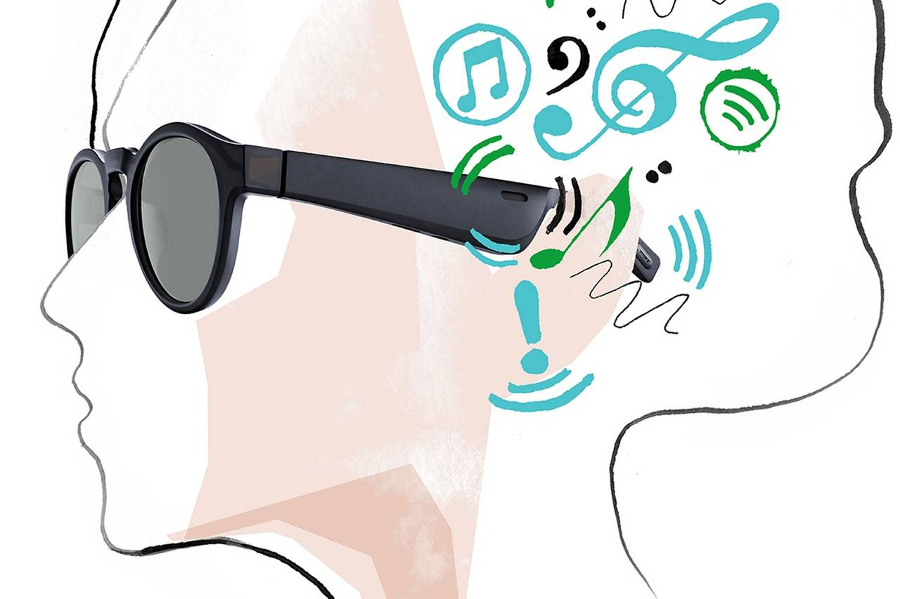
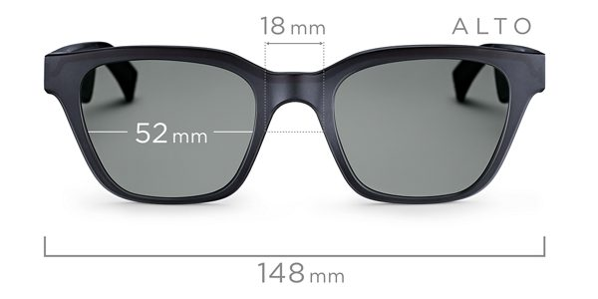
Bose Frames Audio Glasses
Subject: Human Computer Interaction
Name: Haris Anwer
Reg No: 45902
Class: BSIT 7A
Submitting To: Ms. Aniqa

Slide 2
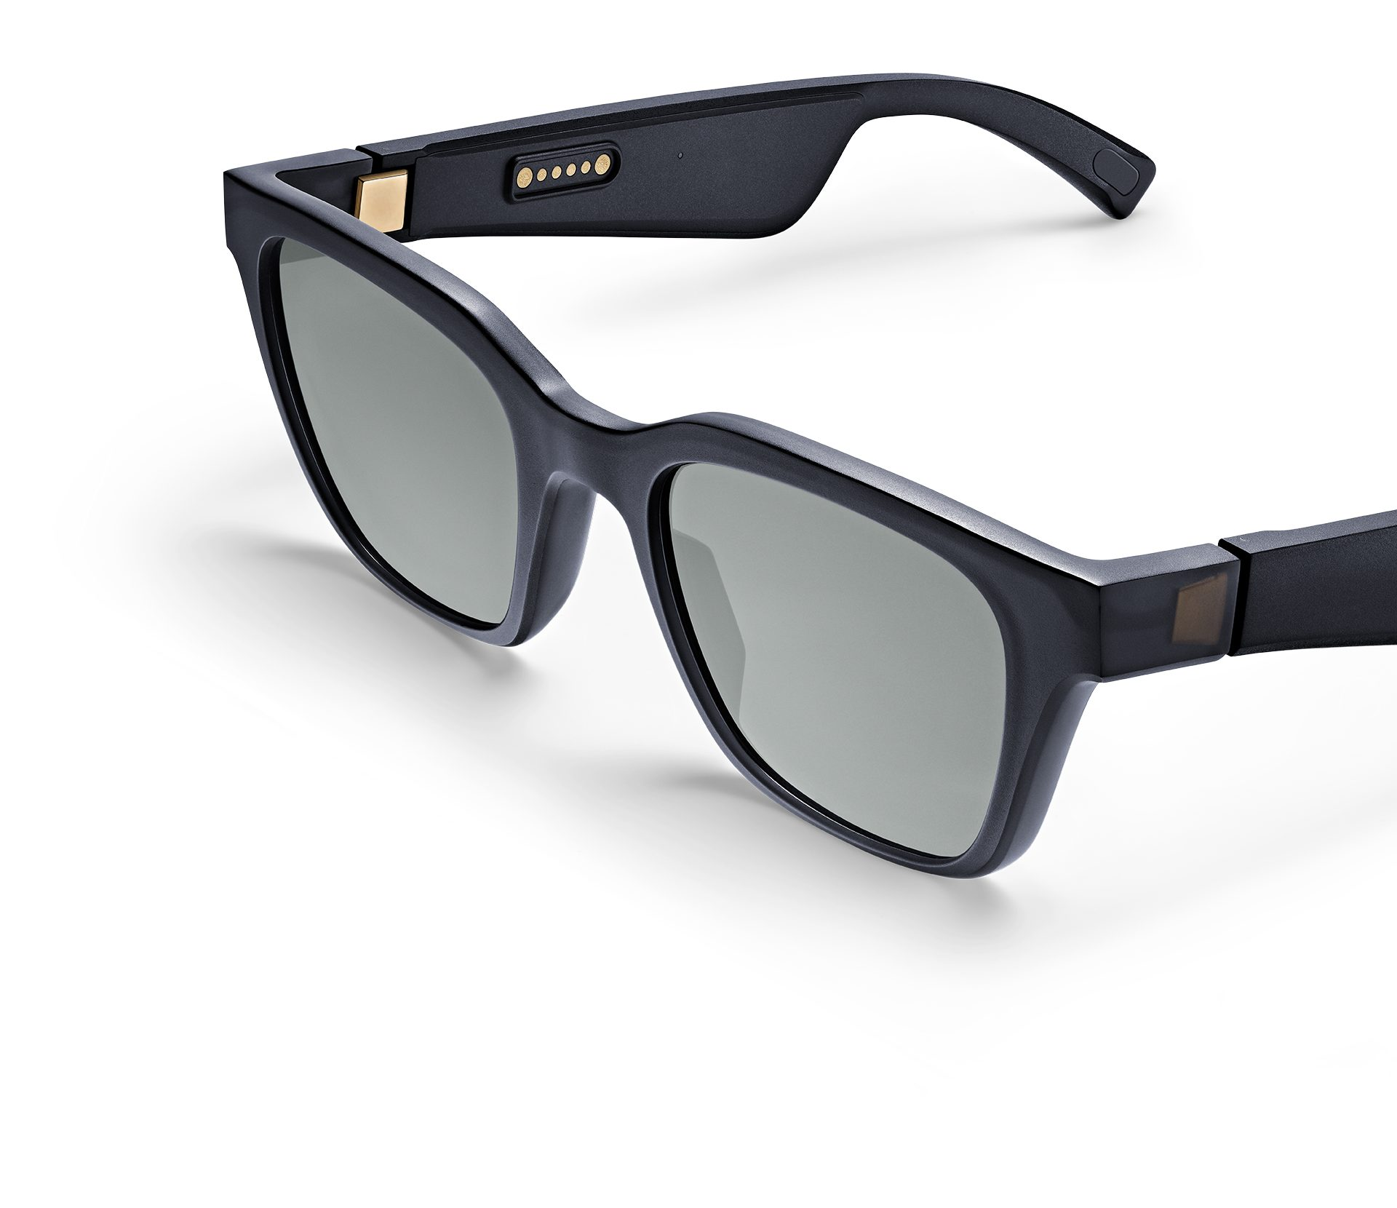
INTRODUCTION:
Bose debuted an audio gadget this year that combined two things, cool sunglasses and wireless earbuds. If you throw a pair of these Bose Frames on during a sunny day spent outside, the frames themselves will play music, streamed from your phone via Bluetooth connection, exclusively for your ears.
SPECIALTIES:
Sound for You & only You:
No one else will be able to hear your music playing. The speakers are that good. You hear rich, immersive sound, while others hear practically nothing. Exclusive technologies and custom speakers direct sound at you and away from others.
Ultramodern Material:
Metal hinges. Nylon rims. Lenses that won’t easily scratch or shatter. Bose Frames are forged from materials as modern as their concept. They’re meticulously molded for comfort and built to last.
Simple Design:
Its easy to use design increases its usability. It looks sober to wear.
Market Price:
This product is easily available, can buy from amazon.com in just $ 199.0.

